Slide 1

Project Business Case Insert Project Name
Confidential
Author: Insert your own text
Project Sponsor: Insert your own text
Project Manager: Insert your own text
Change Manager: Insert your own text
Date: Insert your own text
Version No: Insert your own text
Status: E.g., 1.0 for final/ 0.1 for drafts
Insert your own logo

Slide 2
Guide
You can use this deliverable directly for your own purposes. You simply need to insert your logo and adjust the slides based on the specificities of your organization.
Please note that this document also includes many slides with best practices, tutorials and real-life examples to help you adjust this deliverable based on the specificities of your organization. These slides have an orange rectangle in the top-right corner. You may decide to delete these slides as they are mainly there to help you fill in the rest of the deliverable. Before you do, copy and paste this document so you always have the original version in case you need it.

Slide 3
Purpose
A Project Business Case should be created for each potential project.
Each Project Business Case will answer the following 3 key questions:
Is there a strategic alignment between the project and the corporate and business strategy? If the answer to this question is “No”, then there is no point answering the following 2 questions, as the project will have to be rejected.
How much value will the project create?
How easy it will be to implement the project?
The answer to these 3 questions will help us rate the project and position it on our Prioritization Matrix.
The Prioritization Matrix will help us decide:
If our organization should invest in this project.
If this project should be a “priority 1”, a “priority 2” or a “priority 3” project. “Priority 1” projects should be implemented in the short term, “priority 2” projects should be implemented in the mid-term, and “priority 3” projects should be implemented in the long term.

Slide 4
Document Audience
Insert name (insert role)
Insert name (insert role)
Insert name (insert role)
Insert name (insert role)
Insert name (insert role)
Insert name (insert role)

Slide 5
Document Audience
Real-life example
John Doe (CEO)
Raphael Mina (Chief Financial Officer)
Conor Kriev (Chief Operating Officer)
Patrick Ruffin (Project Sponsor)
Sean Macki (Program Manager)

Slide 6
Lean Business Case Project name: Project description:
Strategic
Alignment
Yes
No
Net Present Value
$16.3M
Value
Ease of implementation
Low
Medium
High
Difficult
Intermediate
Easy
Project Sponsor
John Doe
Project Manager
John Doe
Change Manager
John Doe

Slide 7
Lean Business Case Project name: Project description:
Tutorial
This Lean Business Case is a summary of your business case. It is very important, as your CEO and senior executives may not have time to deep dive into more details.
Strategic
Alignment
Yes
No
Net Present Value
$16.3M
Value
Ease of implementation
Low
Medium
High
Difficult
Intermediate
Easy
Project Sponsor
John Doe
Project Manager
John Doe
Change Manager
John Doe

Slide 8
Project Prioritization
Prioritization matrix
Priority 3 Projects (Actively work to ease the implementation)
Priority 2 Projects
Priority 1 Projects
High
Project XYZ
Unattractive initiatives (do not pursue)
Priority 3 Projects (pursue opportunistically)
Priority 2 Projects
Value
Medium
Unattractive initiatives (do not pursue)
Unattractive initiatives (do not pursue)
Priority 3 Projects (pursue opportunistically)
Low
Difficult
Intermediate
Easy
Ease of implementation

Slide 9
Project Prioritization
Additional Template
Caption:
Priority 1 Projects
Priority 2 Projects
Priority 3 Projects
Unattractive Projects
Prioritization matrix
High
Project XYZ
Value
Medium
Low
Difficult
Intermediate
Easy
Ease of implementation

Slide 10
Project Prioritization
Additional Template
Caption:
Priority 1 Projects
Priority 2 Projects
Priority 3 Projects
Unattractive Projects
Prioritization matrix
Project XYZ
High
Value
Medium
Low
Difficult
Intermediate
Easy
Ease of implementation

Slide 11
Project Business Case Framework
Project Description
Project Assessment
1.Business opportunity & suggested solution
5.Strategic
Alignment
2.Project objectives and key performance indicators (KPIs)
6.Value
7.Ease of Implementation
3.Project scope, approach and high-level plan
4.Deliverables, activities & key success factors

Slide 12
Table of Contents
Project Description
Project Assessment
1.Business opportunity & suggested solution
5.Strategic
Alignment
2.Project objectives and key performance indicators (KPIs)
6.Value
7.Ease of Implementation
3.Project scope, approach and high-level plan
4.Deliverables, activities & key success factors

Slide 13
Business Opportunity & Suggested Solution Replace this text with the key takeaway from this slide
Business Opportunity
Suggested Solution
Describe in this text block the main business opportunity that you have identified
Describe in this text block the solution you suggest

Slide 14
Business Opportunity & Suggested Solution Replace this text with the key takeaway from this slide
Best practices
For some projects, you may need more than one slide to express the business opportunity and suggested solution. However, we recommend that you get straight to the point
Business Opportunity
Suggested Solution
Describe in this text block the main business opportunity that you have identified
Describe in this text block the solution you suggest

Slide 15
Table of Contents
Project Description
Project Assessment
1.Business opportunity & suggested solution
5.Strategic
Alignment
2.Project objectives and key performance indicators (KPIs)
6.Value
7.Ease of Implementation
3.Project scope, approach and high-level plan
4.Deliverables, activities & key success factors

Slide 16
Project objectives and key performance indicators (KPIs)
Project Objectives
Key Performance Indicators
Targets
Insert project objective
Insert Key Performance Indicator
Insert target
Insert project objective
Insert Key Performance Indicator
Insert target
Insert project objective
Insert Key Performance Indicator
Insert target
Insert project objective
Insert Key Performance Indicator
Insert target
Insert project objective
Insert Key Performance Indicator
Insert target

Slide 17
Project objectives and key performance indicators (KPIs)
Real-life example
Project Objectives
Key Performance Indicators
Targets
Increase revenue per customer
Revenue per customer
+20% (From $500 to $600)
Increase customer satisfaction
Increase Net Promoter Score (NPS)
From 80% to 86%
Insert project objective
Insert Key Performance Indicator
Insert target
Insert project objective
Insert Key Performance Indicator
Insert target
Insert project objective
Insert Key Performance Indicator
Insert target

Slide 18
Table of Contents
Project Description
Project Assessment
1.Business opportunity & suggested solution
5.Strategic
Alignment
2.Project objectives and key performance indicators (KPIs)
6.Value
7.Ease of Implementation
3.Project scope, approach and high-level plan
4.Deliverables, activities & key success factors

Slide 19
Project Scope
Category | In scope | Out of scope
Strategy | Insert your own description | Insert your own description
Products | Insert your own description | Insert your own description
Processes | Insert your own description | Insert your own description
Systems | Insert your own description | Insert your own description
Channels | Insert your own description | Insert your own description
Roles | Insert your own description | Insert your own description
Insert category name | Insert your own description | Insert your own description

Slide 20
Project Scope
Tutorial
The categories may vary a lot depending on your business.
Category | In scope | Out of scope
Strategy | Insert your own description | Insert your own description
Products | Insert your own description | Insert your own description
Processes | Insert your own description | Insert your own description
Systems | Insert your own description | Insert your own description
Channels | Insert your own description | Insert your own description
Roles | Insert your own description | Insert your own description
Insert category name | Insert your own description | Insert your own description

Slide 21
Project Team
Insert Name
Project Manager
Insert Name
Insert Role
Insert Name
Insert Role
Insert Name
Insert Role
Insert Name
Insert Role
Insert Name
Insert Role
Insert Name
Insert Role
Insert Name
Insert Role
Insert Name
Insert Role

Slide 22
Project Team
Additional template
Insert Name
Insert Role
Insert Name
Insert Role
Insert Name
Insert Role
Insert Name
Insert Role
Insert Name
Insert Role
Insert Name
Insert Role
Insert Name
Insert Role
Insert Name
Insert Role
Insert Name
Insert Role
Insert Name
Insert Role
Insert Name
Insert Role
Insert Name
Insert Role
Insert Name
Insert Role

Slide 23
Project Team
Additional template
Insert Name
Insert Role
Insert Name
Insert Role
Insert Name
Insert Role
Insert Name
Insert Role
Insert Name
Insert Role
Insert Name
Insert Role
Insert Name
Insert Role
Insert Name
Insert Role
Insert Name
Insert Role
Insert Name
Insert Role
Insert Name
Insert Role
Insert Name
Insert Role
Insert Name
Insert Role
Insert Name
Insert Role
Insert Name
Insert Role
Insert Name
Insert Role
Insert Name
Insert Role
Insert Name
Insert Role
Insert Name
Insert Role
Insert Name
Insert Role
Insert Name
Insert Role
Insert Name
Insert Role

Slide 24
Project Approach
Week | 1 | 2 | 3 | 4 | 5 | 6 | 7 | 8 | 9 | 10 | 11 | 12
Starts on | 7/1 | 14/1 | … | … | … | … | … | … | … | … | … | …
Insert name of Phase I
Insert name of Phase II
Insert name of Phase III

Slide 25
Project High-level Plan
= Key deliverable
Week | 1 | 2 | 3 | 4 | 5 | 6 | 7 | 8 | 9 | 10 | 11 | 12
Starts on | 7/1 | 14/1 | … | … | … | … | … | … | … | … | … | …
Insert name of Phase I
1.1 Insert name of activity
1.2 Activity
1.3 Activity
Phase II
2.1 Activity
2.2 Activity
2.3 Activity
Phase III
3.1 Activity
3.2 Activity
3.3 Activity

Slide 26
Table of Contents
Project Description
Project Assessment
1.Business opportunity & suggested solution
5.Strategic
Alignment
2.Project objectives and key performance indicators (KPIs)
6.Value
7.Ease of Implementation
3.Project scope, approach and high-level plan
4.Deliverables, activities & key success factors

Slide 27

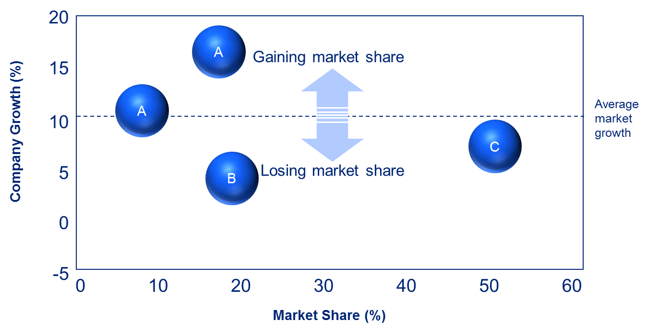
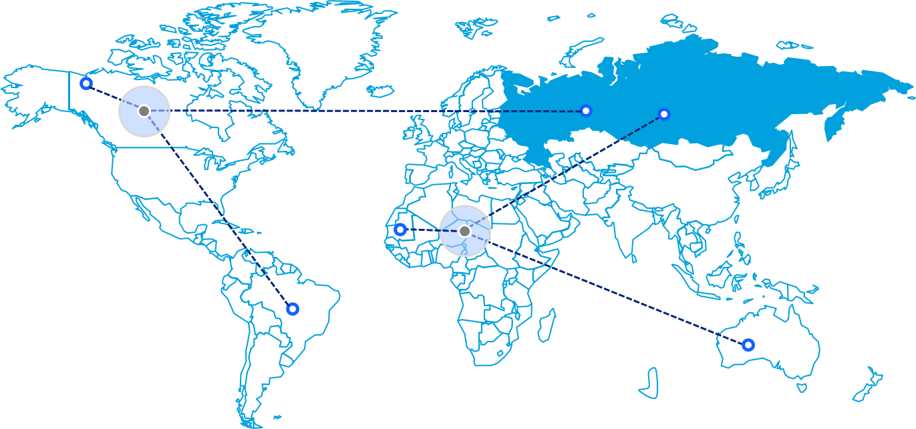
Phase I
1
2
3
Objectives
Replace this text with your own text
Replace this text with your own text
Replace this text with your own text
Key Success Factors
Replace this text with your own text
Replace this text with your own text
Replace this text with your own text
Deliverable examples
Key Activities & Milestones
Replace this text with your own text
Replace this text with your own text
Replace this text with your own text
Replace this text with your own text
Key Deliverables
Replace this text with your own text
Replace this text with your own text
Replace this text with your own text

Slide 28
Phase I
Tutorial
1
2
3
Objectives
Replace this text with your own text
Replace this text with your own text
Replace this text with your own text
Key Success Factors
Replace this text with your own text
Replace this text with your own text
Replace this text with your own text
Deliverable examples
Replace these images with images of your own deliverables so your stakeholders can better imagine what will be done
Key Activities & Milestones
Replace this text with your own text
Replace this text with your own text
Replace this text with your own text
Replace this text with your own text
Key Deliverables
Replace this text with your own text
Replace this text with your own text
Replace this text with your own text

Slide 29
Phase II
1
2
3
Objectives
Replace this text with your own text
Replace this text with your own text
Replace this text with your own text
Key Success Factors
Replace this text with your own text
Replace this text with your own text
Replace this text with your own text
Deliverable examples
Key Activities & Milestones
Replace this text with your own text
Replace this text with your own text
Replace this text with your own text
Replace this text with your own text
Key Deliverables
Replace this text with your own text
Replace this text with your own text
Replace this text with your own text

Slide 30
Phase III
1
2
3
Objectives
Replace this text with your own text
Replace this text with your own text
Replace this text with your own text
Key Success Factors
Replace this text with your own text
Replace this text with your own text
Replace this text with your own text
Deliverable examples
Key Activities & Milestones
Replace this text with your own text
Replace this text with your own text
Replace this text with your own text
Replace this text with your own text
Key Deliverables
Replace this text with your own text
Replace this text with your own text
Replace this text with your own text

Slide 31
Table of Contents
Project Description
Project Assessment
1.Business opportunity & suggested solution
5.Strategic
Alignment
2.Project objectives and key performance indicators (KPIs)
6.Value
7.Ease of Implementation
3.Project scope, approach and high-level plan
4.Deliverables, activities & key success factors

Slide 32
Summary of our corporate and business strategy Mission statement, vision statement and values
Mission Statement
Vision Statement
Values
Insert your own text
Insert your own text
Insert your own text

Slide 33
Summary of our corporate and business strategy Mission statement, vision statement and values
Best practice
Mission Statement
Vision Statement
Values
Insert your own text
Insert your own text
Insert your own text
The summary of the corporate and business strategy should already have been done by the corporate and business strategy team. Each project business case should simply include the summary. Please note that the format of this summary may be different depending on the company. But it usually includes:
Mission statement
Vision statement
Values
Strategic objectives

Slide 34
Summary of our corporate and business strategy Mission statement, vision statement and values
Tutorial
Mission Statement
Vision Statement
Values
This is the company’s reason for existence or purpose.
It describes the overarching intent of the organization.
It is usually defined during a workshop with the top management.
It should provide focus and direction and help guide decision making and actions.
It should be one easily understandable sentence and, if required, a more detailed description below the main sentence.
This describes the organization’s desired or intended state at some point in the near or distant future.
It describes the overarching aim of the organization as it progresses into the future.
Like the Mission Statement, it is usually defined during a workshop with the top management.
It should provide focus and direction and help guide decision making and actions.
It should be one easily understandable sentence and, if required, a more detailed description below the main sentence.
Company values (also called corporate values or core values) are the set of guiding principles and fundamental beliefs that help a group of people function together as a team and work toward a common business goal. These values are often related to business relationships, customer relationships, and company growth. Company values don’t have to be unique; they should be what your company wants to see in itself and its employees. Some examples are “Integrity”, “Trust”, “Accountability”, “Respect” or “Value-centricity

Slide 35
The project is aligned with our mission statement, vision statement and values
Caption:
Aligned
Misaligned
Mission Statement
Vision Statement
Values
Insert your own text
Insert your own text
Insert your own text

Slide 36
Summary of our corporate and business strategy Strategy map including our corporate and business strategic objectives
Perspective
Strategic objectives
Financial
Insert your own text
Insert your own text
Insert your own text
Insert your own text
Insert your own text
Insert your own text
Insert your own text
Customer
Insert your own text
Insert your own text
Insert your own text
Internal Process
Insert your own text
Insert your own text
Insert your own text
Insert your own text
Learning
& Growth
Insert your own text
Insert your own text
Insert your own text
Insert your own text

Slide 37
The project positively impacts many of the corporate and business strategic objectives
Positively impacted by the project
Caption:
Perspective
Strategic objectives
Financial
Insert your own text
Insert your own text
Insert your own text
Insert your own text
Insert your own text
Insert your own text
Insert your own text
Customer
Insert your own text
Insert your own text
Insert your own text
Internal Process
Insert your own text
Insert your own text
Insert your own text
Insert your own text
Learning
& Growth
Insert your own text
Insert your own text
Insert your own text
Insert your own text

Slide 38
Summary of our corporate and business strategy Strategy map including our corporate and business strategic objectives
Tutorial
Perspective
Strategic objectives
Financial
Please note that usually, Fortune 500 companies use the 4 perspectives described in this slide, which were initially introduced by the famous Strategists Norton and Kaplan. However, you may decide to use different perspectives. For example, many of our clients use 4 stakeholder groups such as: Shareholders, Customers, Employees and Communities.
Insert your own text
Insert your own text
Insert your own text
Insert your own text
Insert your own text
Insert your own text
Insert your own text
Customer
Insert your own text
Insert your own text
Insert your own text
Internal Process
Insert your own text
Insert your own text
Insert your own text
Insert your own text
Learning
& Growth
Insert your own text
Insert your own text
Insert your own text
Insert your own text

Slide 39
Summary of our corporate and business strategy Strategy map including our corporate and business strategic objectives
Real-life example
Perspective
Strategic objectives
Financial
Increase profit
Increase revenue
Decrease Costs
Increase number of customers
Increase revenue per customer
Decrease fixed cost
Decrease variable cost
Customer
Increase customer satisfaction
Become a trusted brand
Sell new products
Internal Process
Understand customer segments
Shift to digital channel
Decrease delivery time
Create new products
Learning
& Growth
Improve
employee satisfaction
Improve customer information
Create a customer-focused culture
Align the organization

Slide 40
The project positively impacts many of the corporate and business strategic objectives
Real-life example
Positively impacted by the project
Caption:
Perspective
Strategic objectives
Financial
Increase profit
Increase revenue
Decrease Costs
Increase number of customers
Increase revenue per customer
Decrease fixed cost
Decrease variable cost
Customer
Increase customer satisfaction
Become a trusted brand
Sell new products
Internal Process
Understand customer segments
Shift to digital channel
Decrease delivery time
Create new products
Learning
& Growth
Improve
employee satisfaction
Improve customer information
Create a customer-focused culture
Align the organization

Slide 41
Based on the previous slides, we can conclude that there is a strategic alignment between the project and the corporate and business strategy
5.Strategic
Alignment
Yes
No
6.Value
7.Ease of Implementation
Low
Medium
High
Difficult
Intermediate
Easy

Slide 42
Based on the previous slides, we can conclude that there is no strategic alignment between the project and the corporate and business strategy
Additional template
5.Strategic
Alignment
Yes
No
6.Value
7.Ease of Implementation
Low
Medium
High
Difficult
Intermediate
Easy
As a result, there is no point to assess the value that the project could create, and how easy it is to implement the project.

Slide 43
Based on the previous slides, we can conclude that there is no strategic alignment between the project and the corporate and business strategy
Example
5.Strategic
Alignment
Yes
No
For example, let’s say a Tesla executive tries to launch a project to create a new fuel car. The project will never be approved, as it is misaligned with the vision of the company, which is “to accelerate the world's transition to sustainable energy”.
Even if the project could generate high value a simple implementation, it will still be rejected.
6.Value
7.Ease of Implementation
Low
Medium
High
Difficult
Intermediate
Easy
As a result, there is no point to assess the value that the project could create, and how easy it is to implement the project.

Slide 44
Table of Contents
Project Description
Project Assessment
1.Business opportunity & suggested solution
5.Strategic
Alignment
2.Project objectives and key performance indicators (KPIs)
6.Value
7.Ease of Implementation
3.Project scope, approach and high-level plan
4.Deliverables, activities & key success factors

Slide 45
Project Initial Investment Based on our estimate, the project initial investment will be about $1.08M [insert your own number]
Key Assumptions
Insert key assumption which you used to estimate the project costs
Insert key assumption which you used to estimate the project costs
Insert key assumption which you used to estimate the project costs

Slide 46
Project Costs Based on our estimate, the project costs will be about $3.9M [insert your own number] over the next 5 years
Key Assumptions
Insert key assumption which you used to estimate the project costs
Insert key assumption which you used to estimate the project costs
Insert key assumption which you used to estimate the project costs

Slide 47
Project Costs Based on our estimate, the project costs will be about $3.9M [insert your own number] over the next 5 years
Best practice
The best practice is to create a financial model in Excel.
Then you can copy and paste the table into the PowerPoint by using the paste option “Picture” or, for better quality, “Picture enhanced metafile”.
To create the table and charts in this document, we used the document called Project Financial Model. Please note that if you need a more complex financial model, you can also use the Excel document called Sophisticated Financial Model.
Key Assumptions
Insert key assumption which you used to estimate the project costs
Insert key assumption which you used to estimate the project costs
Insert key assumption which you used to estimate the project costs
Don’t forget to mention all the key assumptions that you used.

Slide 48
Additional Revenue Generated Based on our estimate, the additional revenue generated by the project will be about $20M [insert your own number] over the next 5 years
Key Assumptions
Insert key assumption which you used to estimate the project costs
Insert key assumption which you used to estimate the project costs
Insert key assumption which you used to estimate the project costs

Slide 49
Additional Revenue Generated Based on our estimate, the additional revenue generated by the project will be about $20M [insert your own number] over the next 5 years
Best practice
The Additional Revenue of an item is usually calculated by:
Creating a baseline where you estimate the future revenue of the company without the project being implemented
Estimating the future revenue of the company with the project being implemented
Comparing the two estimates
Key Assumptions
Insert key assumption which you used to estimate the project costs
Insert key assumption which you used to estimate the project costs
Insert key assumption which you used to estimate the project costs

Slide 50
Cost Savings Based on our estimate, the cost savings generated by the project will be about $7M [insert your own number] over the next 5 years
Key Assumptions
Insert key assumption which you used to estimate the NPV
Insert key assumption which you used to estimate the NPV
Insert key assumption which you used to estimate the NPV
For more details, please refer to the Excel document called Project Financial Model

Slide 51
Project cash flow Formula
Project Cash Flow
Additional Revenue Generated
Cost Savings
Project Costs
Project Initial Investment
=
+
-
-

Slide 52
Project cash flow Based on our estimate, the project cash flow generated by the project will be about $20M [insert your own number] over the next 5 years
For more details, please refer to the Excel document called Project Financial Model

Slide 53
Net Present Value (NPV) Formula
The Net Present Value (NPV) presents the present value of future cash flows.
Because money today could be earning interest, a dollar received in the future is worth less than a dollar received today.
As a result, we need apply a discount rate to these future cash flows in order to get their Present Value.

Slide 54
Discount rate
Our company has a standard assumed discount rate provided by the Finance department.
This discount rate has been calculated based on the Weighted Average Cost of Capital (WACC), that is to say the cost of receiving money from our banks and shareholders.
In our example, the company has a discount rate R of 9%

Slide 55
Net Present Value (NPV) Based on our estimate, the NPV generated by the project will be about $16.3M [insert your own number] over the next 5 years
Net Present Value (NPV)
$16.3M
Key Assumptions
Insert key assumption which you used to estimate the NPV
Insert key assumption which you used to estimate the NPV
Insert key assumption which you used to estimate the NPV
For more details, please refer to the Excel document called Project Financial Model

Slide 56
Based on the Net Present Value, we can conclude that the value created by the project is “High”
5.Strategic
Alignment
Yes
No
Net Present Value
$16.3M
6.Value
7.Ease of implementation
Low
Medium
High
Difficult
Intermediate
Easy

Slide 57
Table of Contents
Project Description
Project Assessment
1.Business opportunity & suggested solution
5.Strategic
Alignment
2.Project objectives and key performance indicators (KPIs)
6.Value
7.Ease of implementation
3.Project scope, approach and high-level plan
4.Deliverables, activities & key success factors

Slide 58
We rated the “Ease of implementation” of the project “Intermediate”
Difficult
Intermediate
Easy
Project duration
Long project
Average duration
Short project
Project initial investment and Project costs
High
Average
Low
Project risk
High
Average
Low
Number of people required to implement the project
High
Average
Low
Number of people heavily impacted by the change
High
Average
Low

Slide 59
We rated the “Ease of implementation” of the project “Intermediate”
Tutorial
Difficult
Intermediate
Easy
Project duration
Long project
Average duration
Short project
Project costs
High
Average
Low
Project risk
High
Average
Low
Based on your organization, you will have to give a little bit more details on this slide. For example, what does high project costs mean? A $1M project cost is high for a startup but very low for a Fortune 500 companies.
Number of people required to implement the project
High
Average
Low
Number of people heavily impacted by the change
High
Average
Low

Slide 60
Project Business Case Summary
5.Strategic
Alignment
Yes
No
Net Present Value
$16.3M
6.Value
7.Ease of implementation
Low
Medium
High
Difficult
Intermediate
Easy

Slide 61
Project Prioritization
Prioritization matrix
Priority 3 Projects (Actively work to ease the implementation)
Priority 2 Projects
Priority 1 Projects
High
Unattractive initiatives (do not pursue)
Priority 3 Projects (pursue opportunistically)
Priority 2 Projects
Project XYZ
Value
Medium
Unattractive initiatives (do not pursue)
Unattractive initiatives (do not pursue)
Priority 3 Projects (pursue opportunistically)
Low
Difficult
Intermediate
Easy
Ease of implementation

Slide 62

Interested in more than 1 Toolkit? Access all our Toolkits for half the price with our Gold Access
Gold Access
Click here to learn more

Slide 63
Thanks for your attention!
www.domontconsulting.com

